Slide 1
CT Project Weekly Status Report
Jack Xu, Jenny Jiang Jul 24, 2020

Slide 2
Our work this week
Switched to the latest Contact Shield SDK
Updated methods both on client side and on server side
Created an instance and implemented methods to make the kit work
Generally, we made the system work from end to end
Made a public portal webpage
Used for deployment
Created Deployment Document
Included detailed Instructions for deployment
Created Demo Application

Slide 3
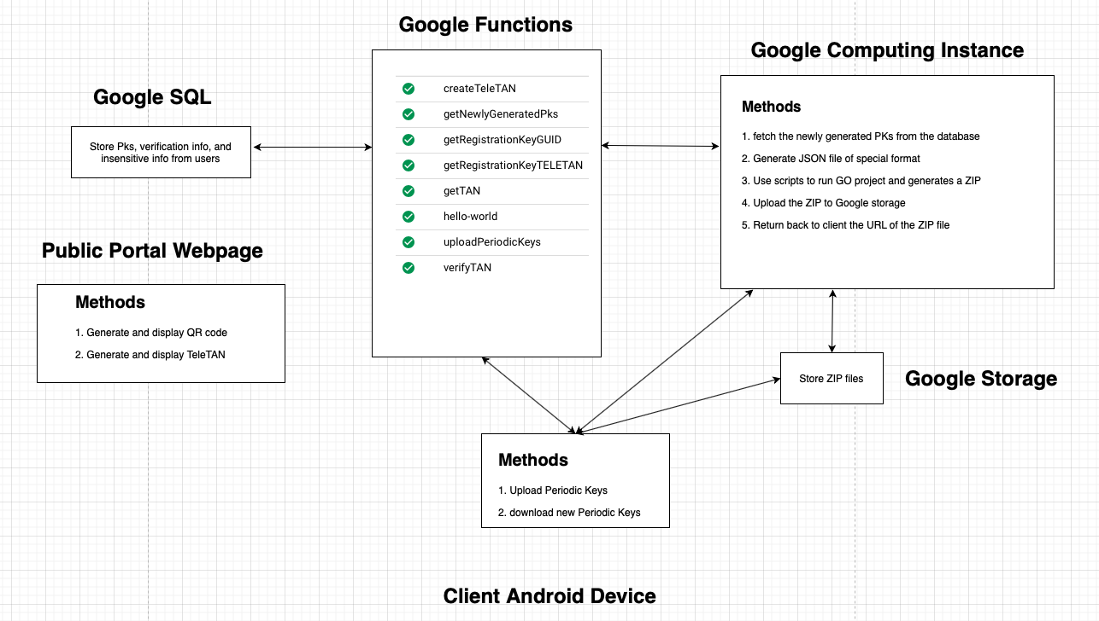
Current System diagram

Slide 4
Demo

Slide 5
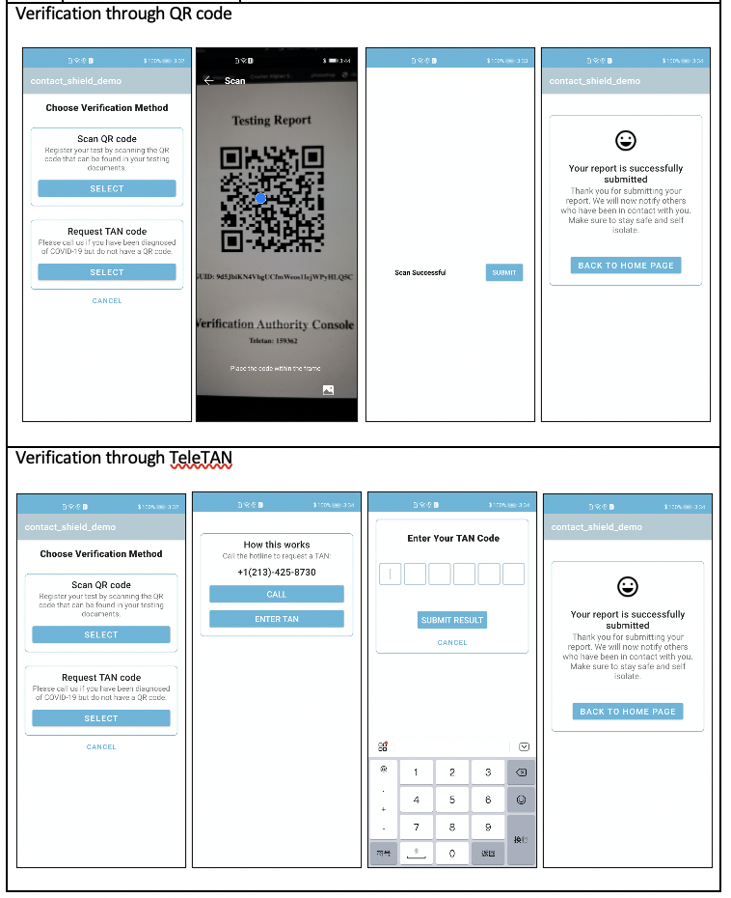
Deployment Scenario
The purpose of the deployment of this application is to demonstrate the capabilities of the Contact Shield API developed by Huawei. This application is only deployed to a small number of users due to restrictions of the Contact Shield API. We will collect the statistics and display the results on our dashboard created from our Google Cloud database. Realistically, there are no real Covid-19 patients that are going to participate in the deployment, we will need to designate some devices as the patient device, and others non-patient to help us complete the interactions. We will have a website that functions as the testing center, which provides information needed to complete the deployment. The website address is http://35.239.227.130:5000/portal. Please follow the guide for using the application and completing the testing scenarios detailed in this document.

Slide 6
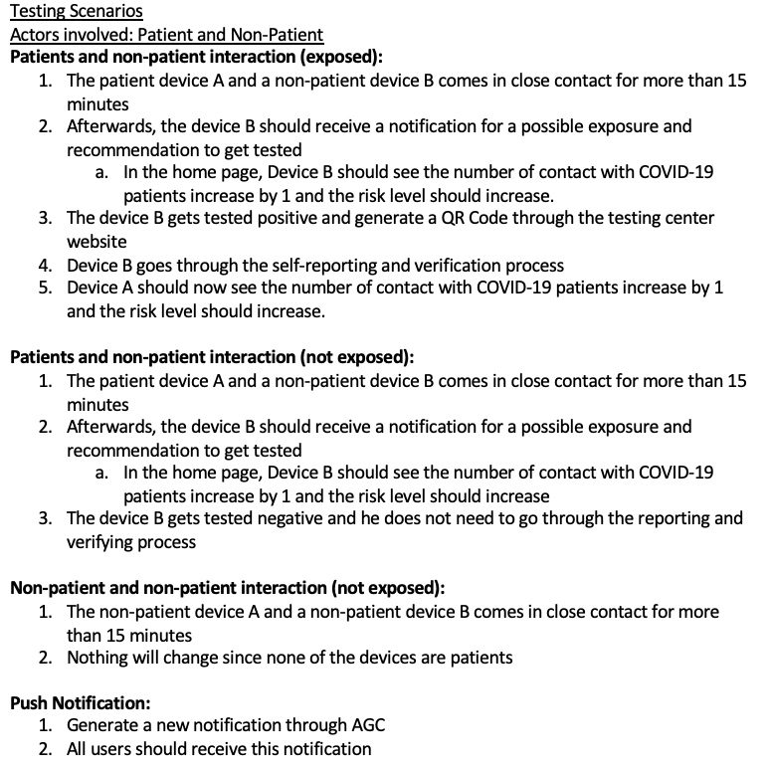
Deployment Scenario (cont.)

Slide 7
Plans for next week
Test and fix bugs
Fix deployment document
Test different scenarios

